Slide 1
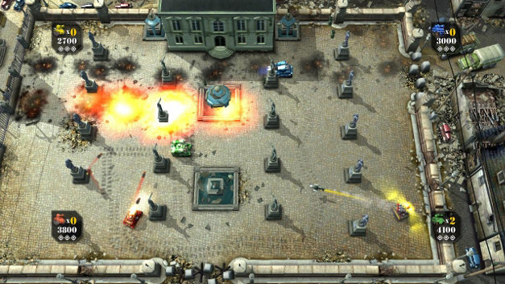
Melbourne Coding Club
First Lesson in Artificial Intelligence in Robots and Games

Slide 2
Define ‘smart’
Awareness of:
Self
Environment
Others alike
Others not alike
Autonomy in:
Making decisions
Movements
“Free-will”
Ability to learn and adapt

Slide 3
How can you program ‘smart’ in computer games
Basic methods:
Hard-coding
Referencing, i.e. external pre-conditions
Advanced methods:
Analysing, interpreting, categorising, prioritising, calculating, making judgements, considering actions, making actions.
Even more advanced methods:
Predicting, adapting, and refining

Slide 4
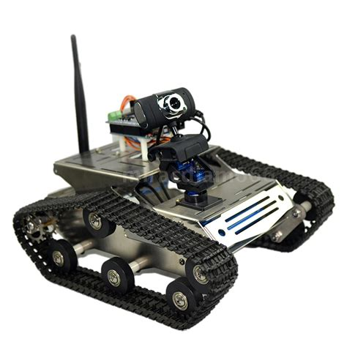
Decision-making process
Decision making, based on available condition
Inputting the conditions
Sensing changes

Slide 5
2D Tank Edge Detection Case
Environment: Screen is 600x400.
Condition: Is my current location equals or more than the edge parameters.
Action: When parameter is reached, stop, then decide where to move next.

Slide 6
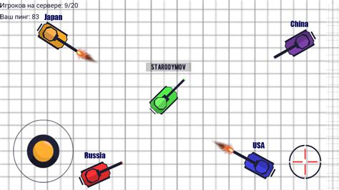
2D Tank Random Direction Case
Simulated intelligence
Not real intelligence. Movements and directions are base on random numbers.
Simplified direction:
Cardinal
Clock

Slide 7
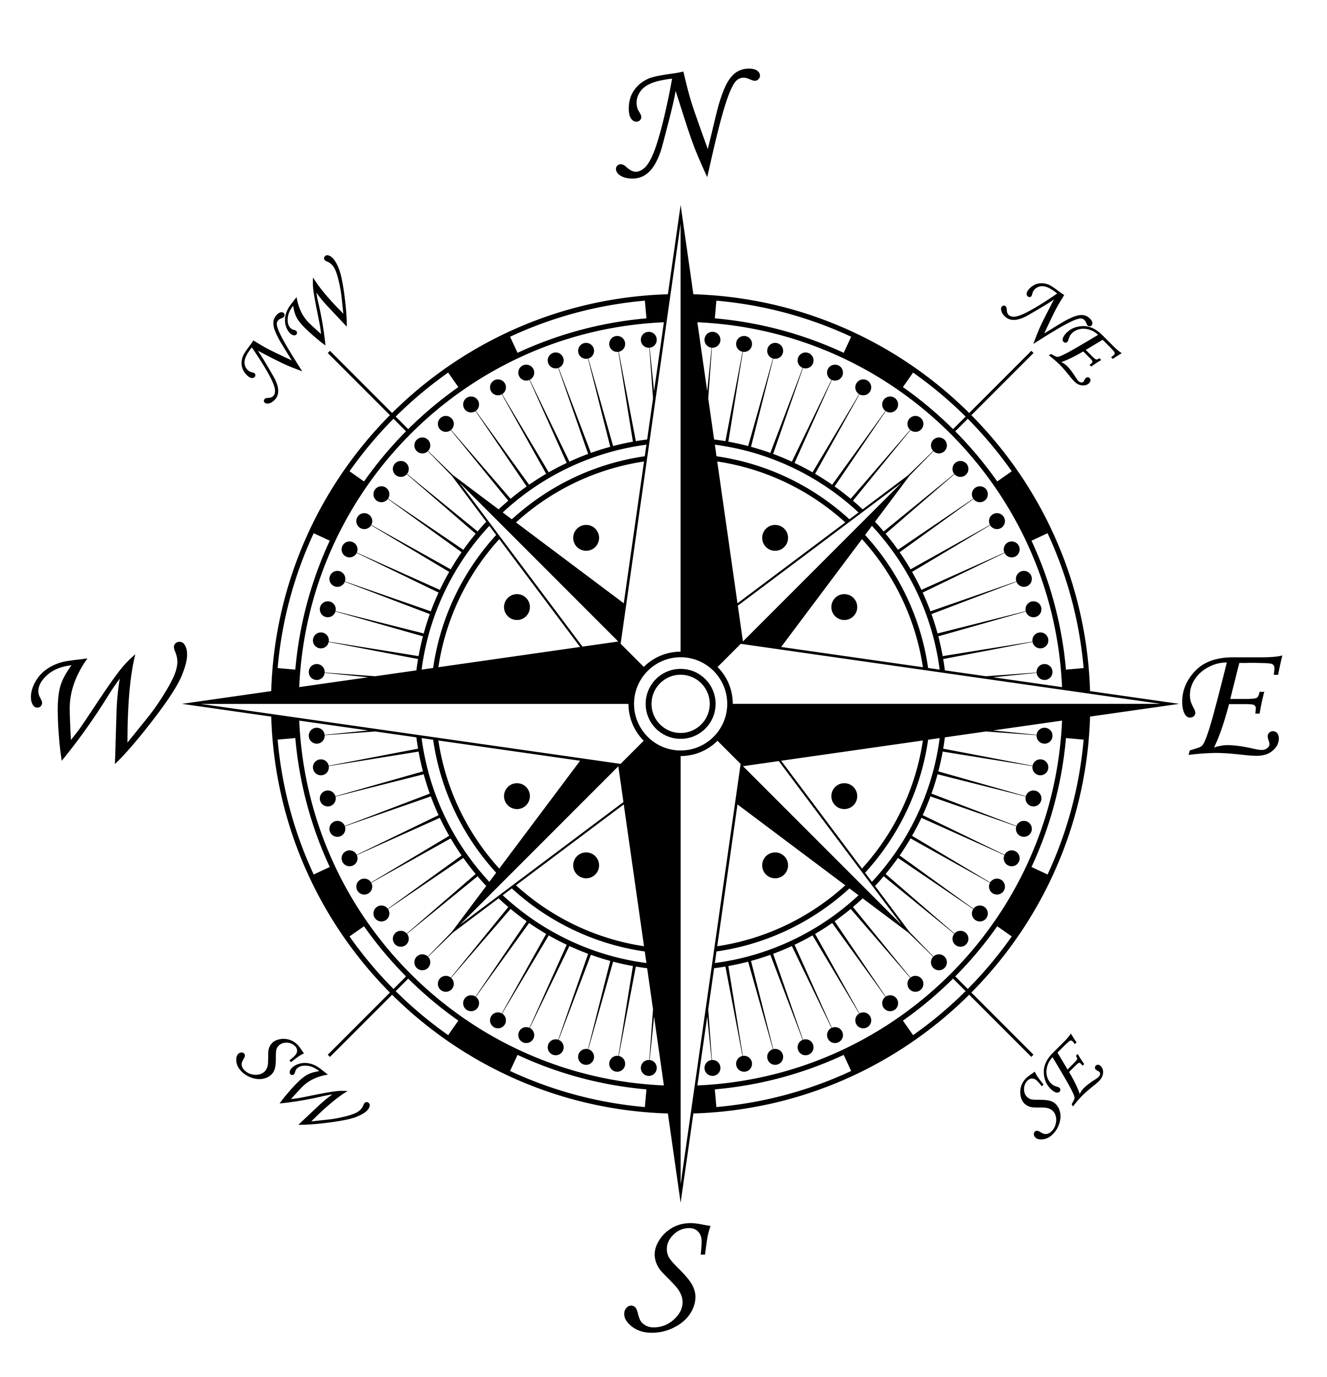
Sense of direction

Slide 8
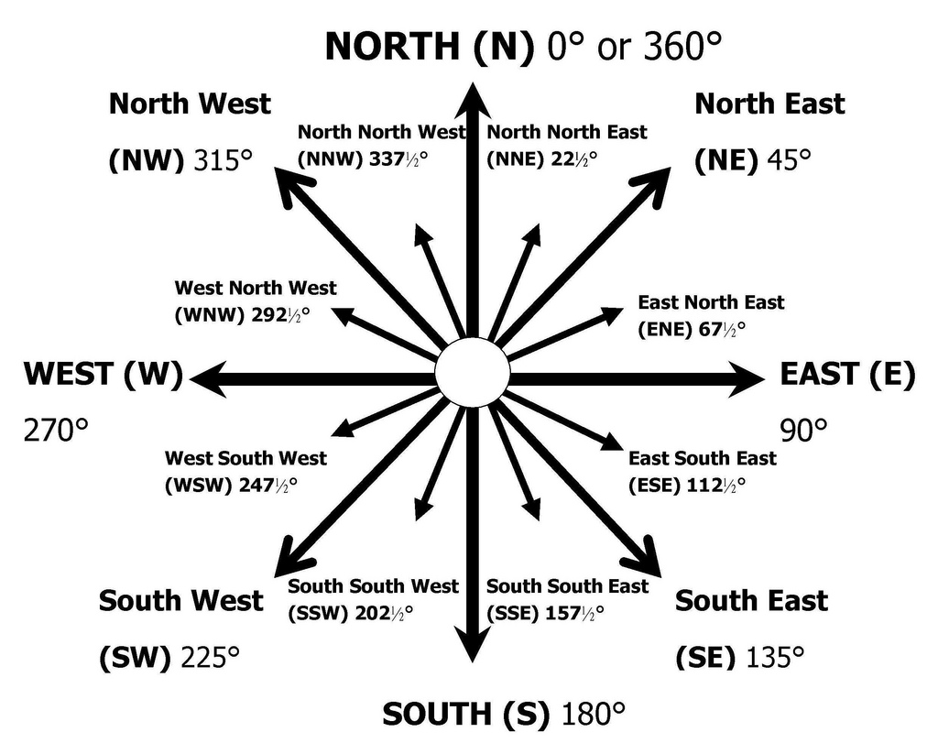
Cardinal System

Slide 9
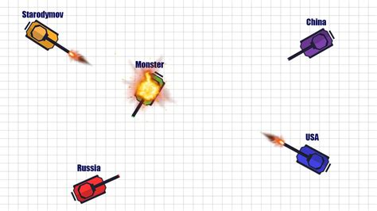
Sensing the environment

Slide 10
Plotting Next Location
Reasons to make a move based on character tendency:
Defensive stance
Dodging bullets, avoiding enemies
Attack when attacked
Offensive stance
Hunger, needs, wants
Hunt for targets
Neutral stance
Move randomly
Friendly stance
Find allies, make coalitions

Slide 11
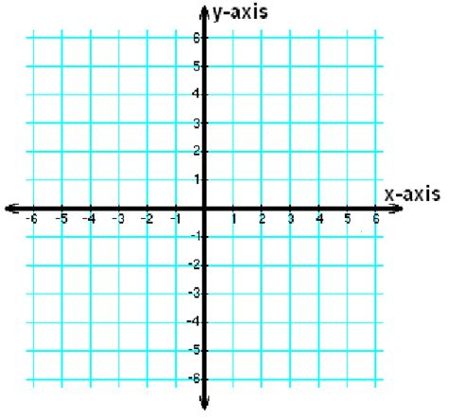
Plotting

Slide 12
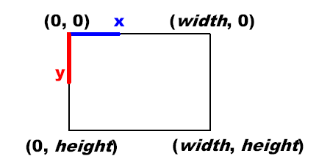
Drawing in 2D world

Slide 13
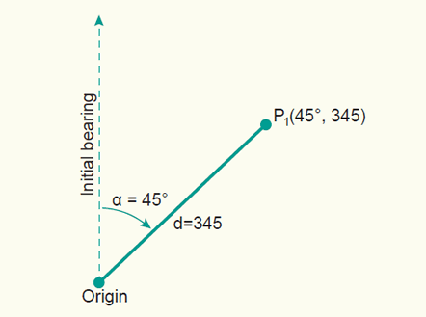
Rotating

Slide 14
Simplified Next Location Matrix
Direction | X | Y
North | None | -
North East | + | -
East | + | None
South East | + | +
South | None | +

Slide 15
Exercise
Plan your tank next move.
Draw the tank’s original position: Po(x,y)
Draw the tank in the next position: Pn(x,y)

